Slide 1
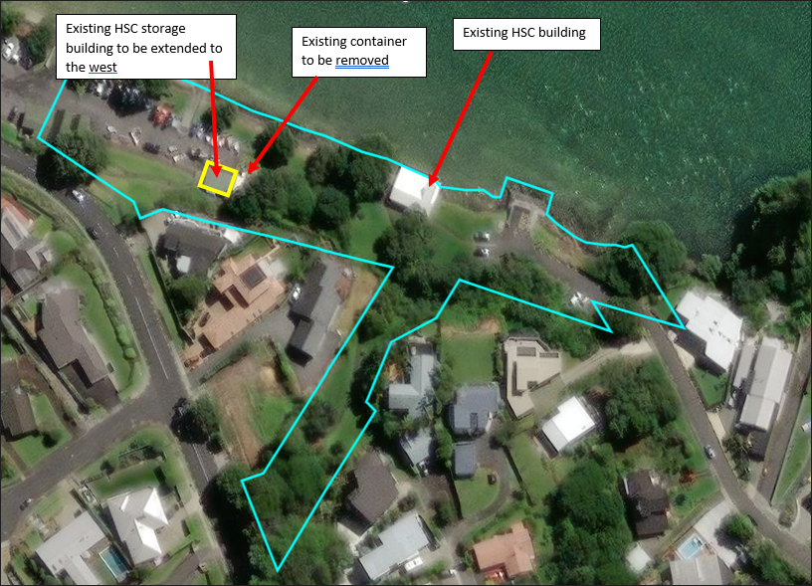
Location of proposed extension within Howick Beach
Notes:
Existing HSC storage building and HSC building- clubhouse is on one single community lease contract

Slide 2
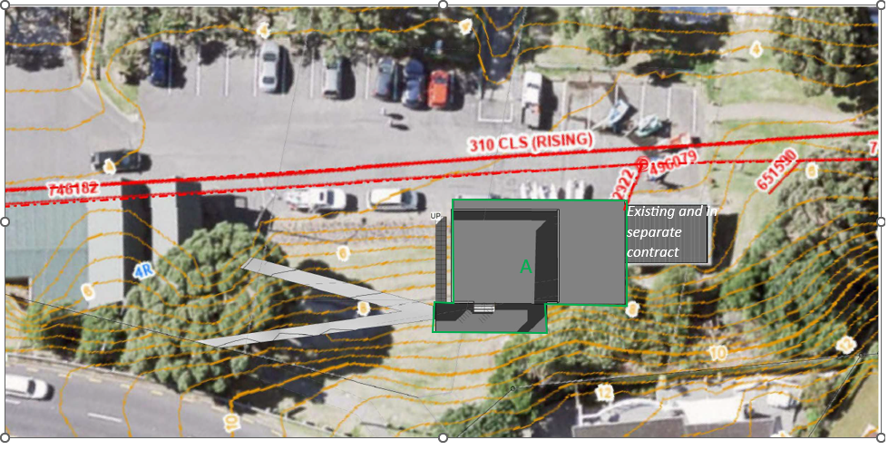
Site Plan
Extension

Slide 3
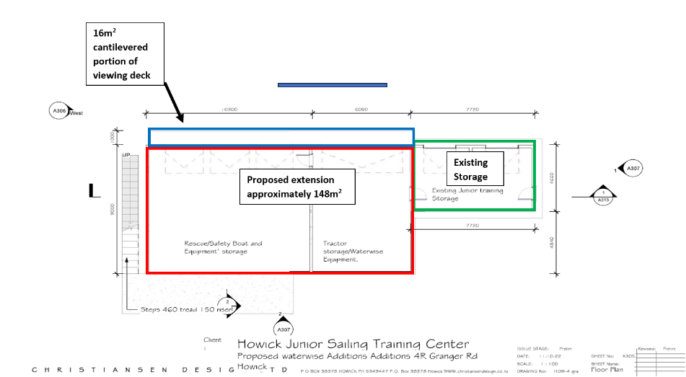
Floor plan showing the area of the proposed extension to the storage building
~26m²

Slide 4
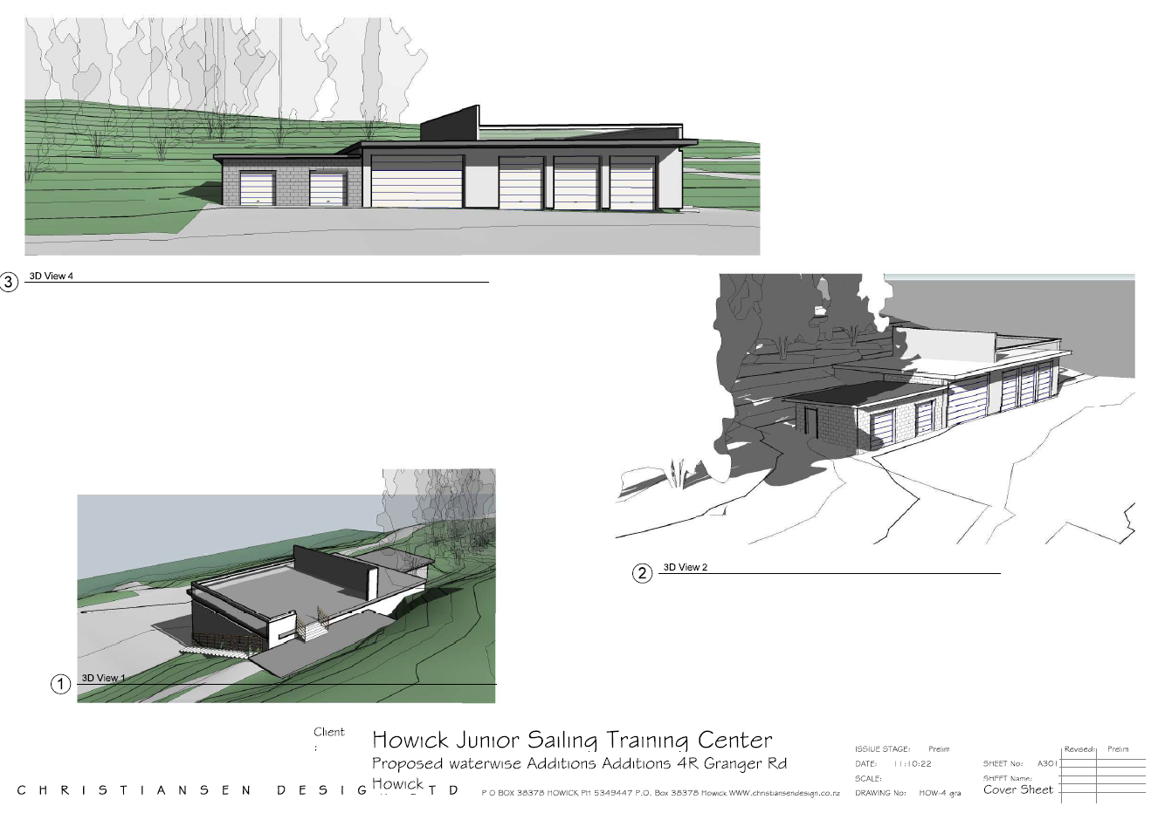
3D View Plans of existing building and proposed extension

